Slide 1


DeepDive Inc.
IIME
Group V

Slide 2
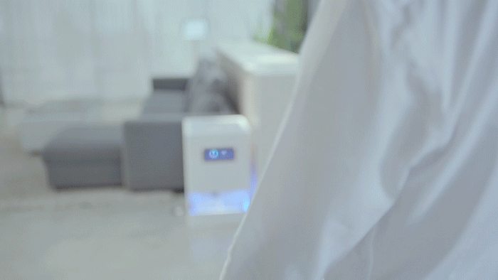
Is this idea for new venture clear?
Solves problem of wired charging
Universal compatibility
More durable
Minimal heating as compared to wired charging
Can use your device even when its getting charged

Slide 3
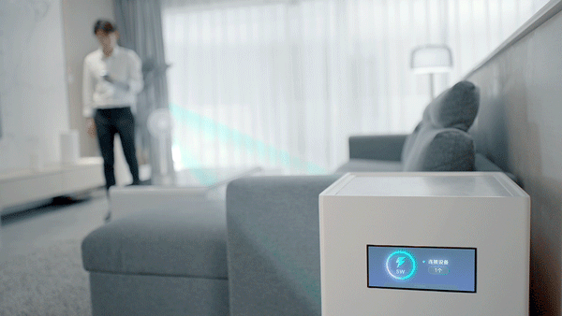
Is it tech push or market pull and why is it so interesting
Tech Push
Remotely charge multiple devices within a radius of several meters with obstacles
Future workplace or living environment will be completely wireless
No need to buy Apple charger anymore (for iPhone users)

Slide 4
Hypothesis that need to be true for our venture to succeed

Slide 5
When will we walk away from this effort

Slide 6
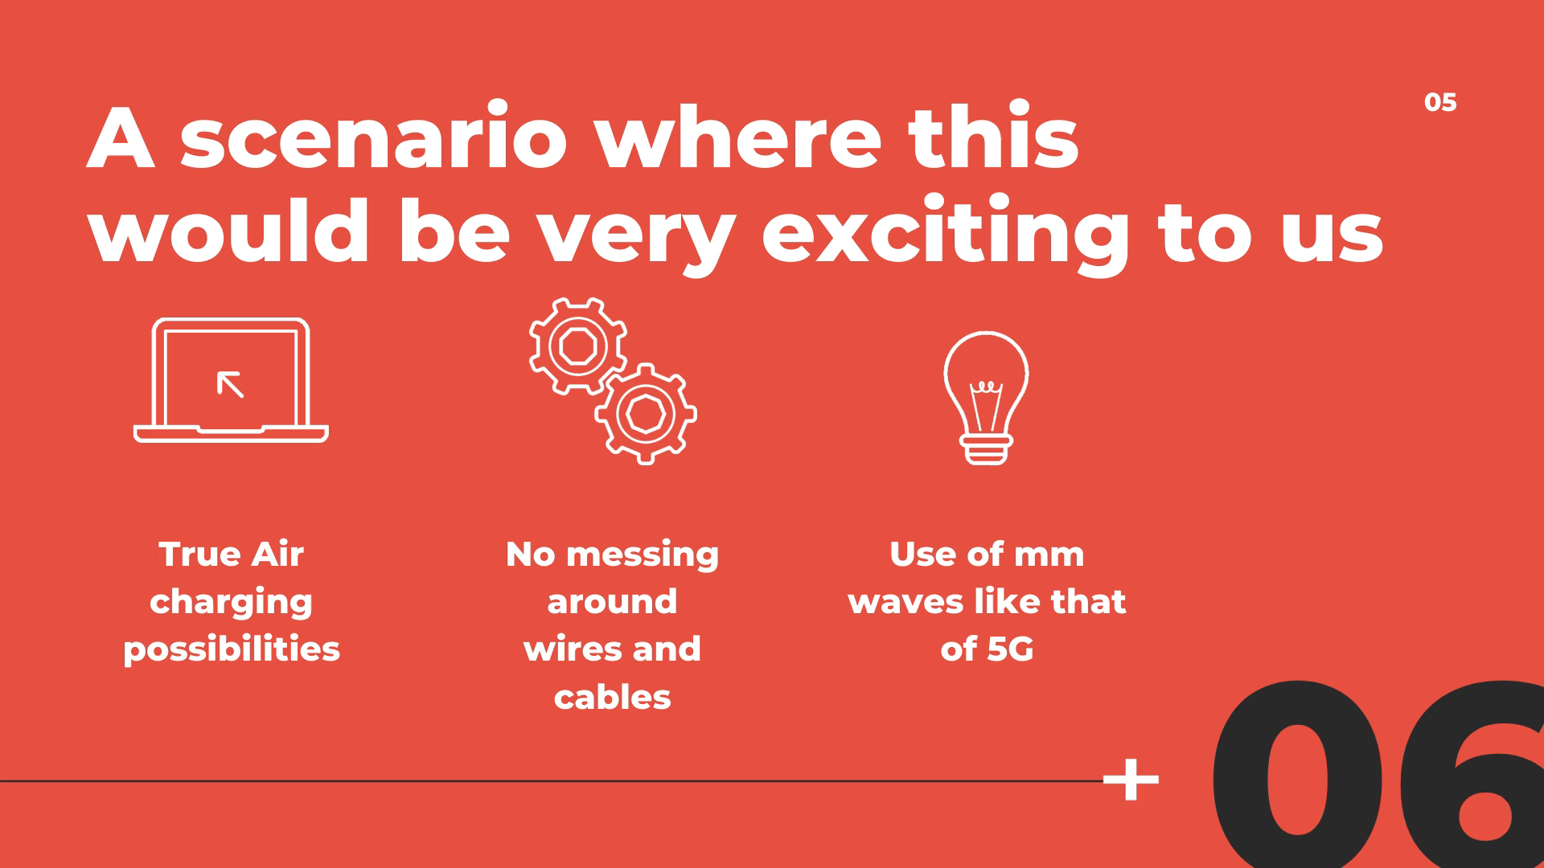

Scenario where this would be very exciting to us
True Air charging possibilities
No messing around wires and cables
Use of mm waves like that of 5G

Slide 7
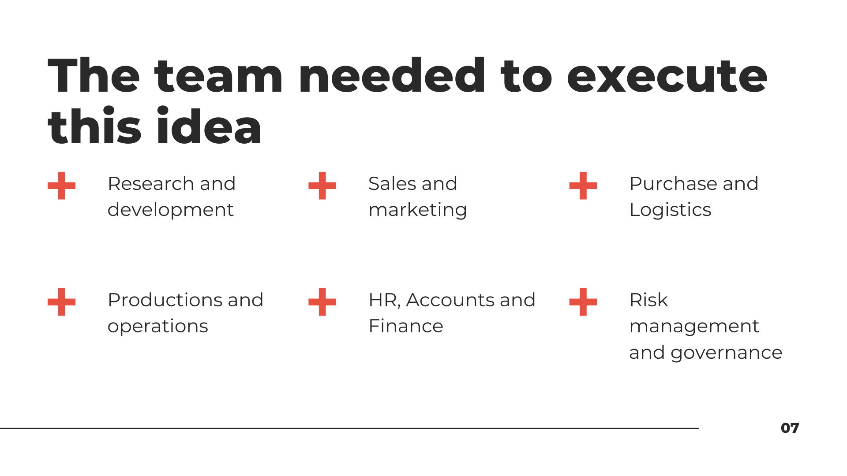
Team needed to execute this idea
Research and development Sales and marketingPurchaseLogisticsProductions and operations HRAccounts and FinanceRisc management and governance

Slide 8

Thank You

